Slide 1
P2P Data Leakage (Web History)
Malcolm Hayward
University of Baltimore
Forensic Science – Cyber Investigations

Slide 2
Previous Presentations
0. Lab Setup
1. Disk Image and Partitions
2. Registry and File Directory
3. MFT Timeline
4. USN Journal Timeline
5. uTorrent Log File
6. File Signature
7. Email

Slide 3
Objectives
Determine
Determine what web browser(s) the suspect used.
Analyze
Analyze the web history.
Determine
Determine how the suspect uploaded a torrent file on the Internet.
Locate
Locate the origin of the torrent trackers.
Be
All timestamps will be in UTC.

Slide 4
15. Locate all web browsers. Identify where the history files are for these browsers.
Tools used:
None
This question does not require tools.

Slide 5
What web browser is the suspect using?
Based on the output from Regripper’s uninstall plugin, there are no entries for any other browser aside from Microsoft Edge.
This could mean that the suspect uninstalled other browsers, or never installed them at all.
You could verify if any files related to other browsers existed on the system by looking at the MFT or USN Journal.
If the suspect uninstalled browsers, it is possible we could still see certain configuration files on the system.
The browsers on the system must be the stock browsers that come with Windows
Microsoft Edge and Internet Explorer.

Slide 6
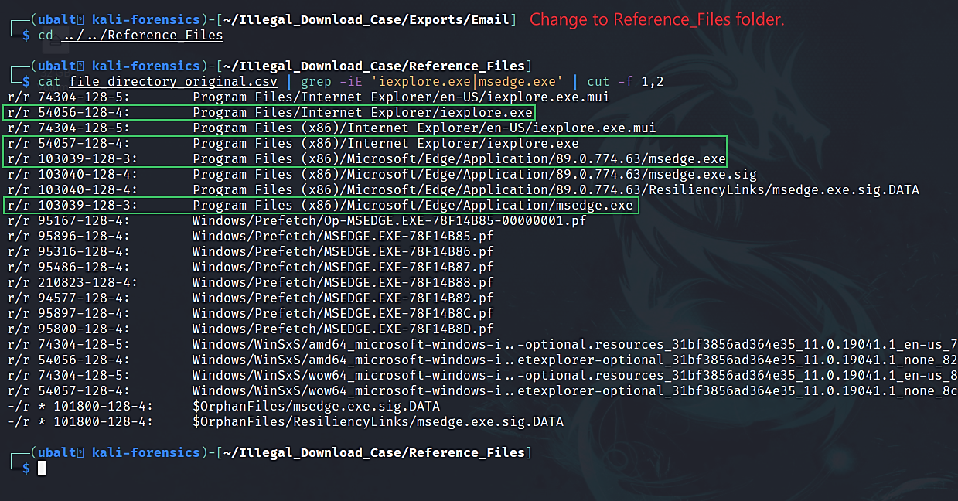
Reference the file directory csv file to locate Microsoft Edge and Internet Explorer.

Slide 7
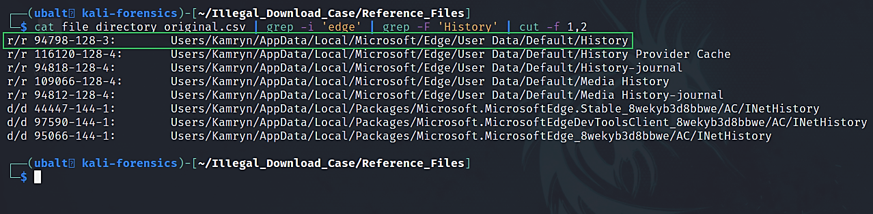
Reference the file directory csv file to locate Microsoft Edge’s history file.

Slide 8
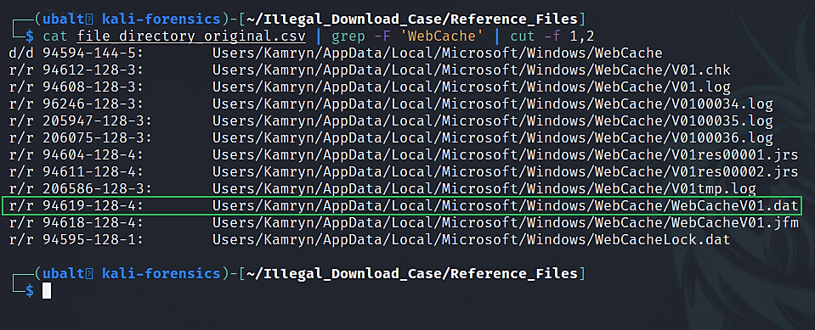
Reference the file directory csv file to locate Internet Explorer’s history file.

Slide 9
Explanation
There are executables for Microsoft Edge and Internet Explorer.
This confirms that Edge and Internet Explorer are the only browsers on the suspect’s system at the time of capture.
By looking at the browser history, we can answer some important questions:
Where and when was uTorrent downloaded?
Where did the suspect get trackers from?
Were any of the torrent or .mp3 files uploaded to a website?

Slide 10
16. Analyze the browsing history. Are there any websites, downloads, or searches of interest?
Tools used:
Icat
Sqlite3
GUI Tool to consider: DB Browser for Sqlite

Slide 11
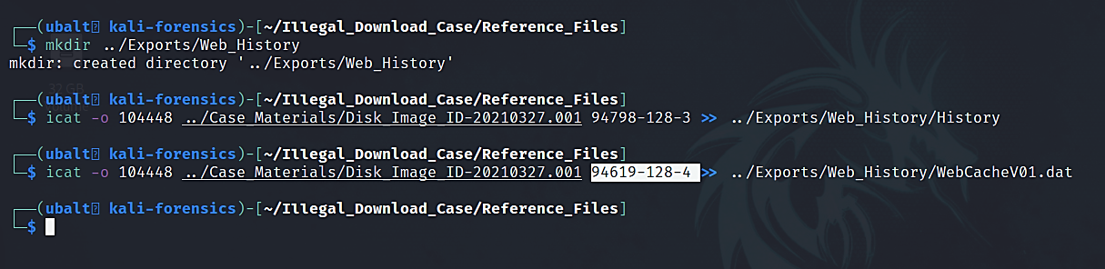
Use icat to extract history files.

Slide 12
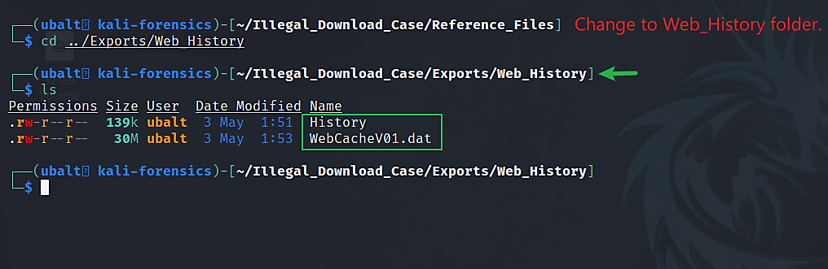
Verify that you have the history files.

Slide 13
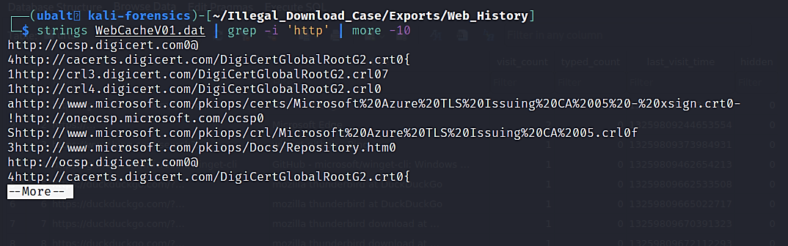
Use strings to quickly look through Internet Explorer’s history.

Slide 14
Explanation
After extracting the history files, we used strings on Internet Explorer’s history file. This was to verify whether the suspect used Internet Explorer to browse any websites.
If so, we would use a tool from the ‘libesedb-utils’ package to parse this file.
There is nothing of interest in Internet Explorer’s history, so we will solely focus on Edge’s history file.

Slide 15
How to use sqlite3.
Sqlite3 is a terminal-based tool that lets you create and edit sqlite databases.
Browsers such as Chrome and Firefox store browsing history in sqlite databases. Therefore, we will use this tool to read them.
Since Edge is now a Chromium-based browser, sqlite3 can read its history file.
When you run this program, you will get a prompt like this: sqlite>
The commands typed inside this prompt differs from the commands you type into the terminal. Some that are used in this demonstration start with periods while others do not.
When in doubt, type ‘.help’ to get help. Or, for tutorials on searching for items in sqlite databases, reference the ‘Querying Data’ section here.

Slide 16
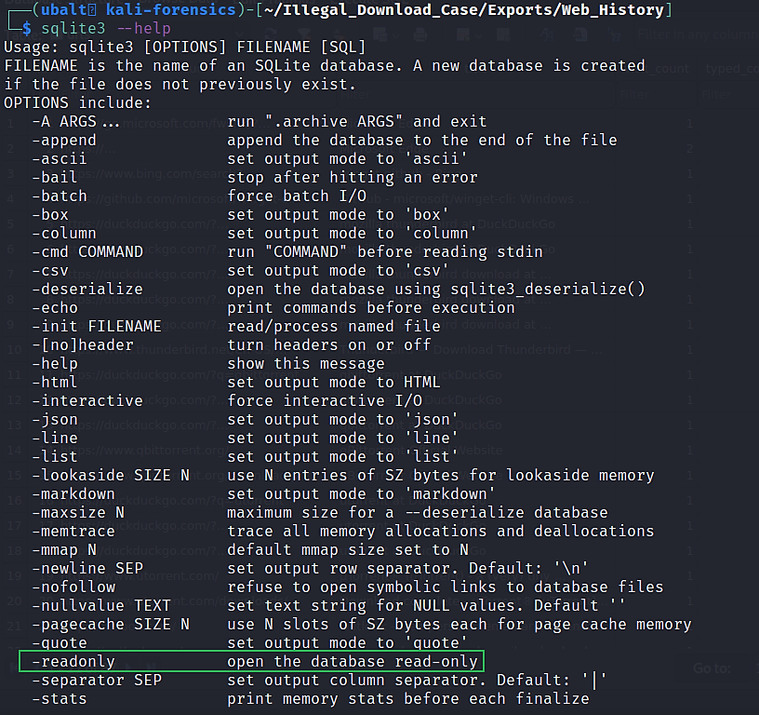
How to get help for sqlite3.

Slide 17
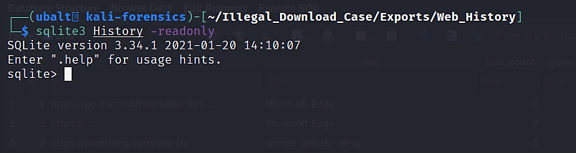
Use sqlite3 to open Edge’s history file in read-only mode.

Slide 18
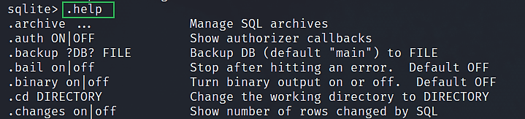
How to get help for sqlite3’s prompt.

Slide 19
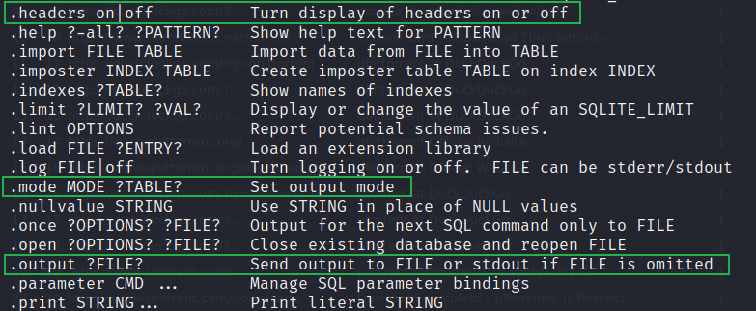
How to get help for sqlite3’s prompt.

Slide 20
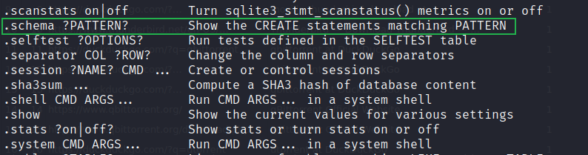
How to get help for sqlite3’s prompt.

Slide 21
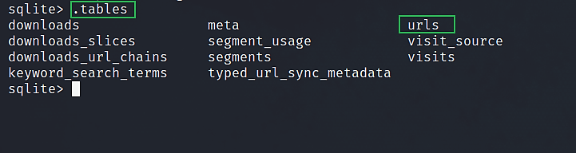
Use ‘.tables’ to figure out what tables are in the history file.

Slide 22
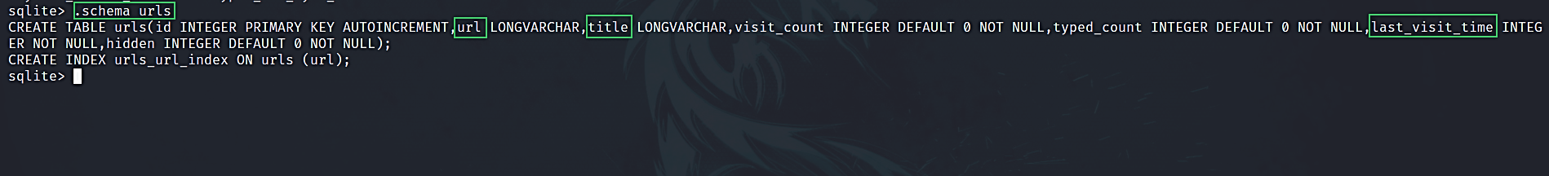
Use ‘.schema’ to determine what fields are in the urls table.

Slide 23
Explanation
The ‘urls’ table stores the website hyperlinks that the suspect visited.
‘Url’, ‘title’, and ‘last_visit_time’ are columns within the ‘urls’ table.
‘url’ will list the hyperlinks.
‘title’ will list the titles each webpage had if applicable.
‘last_visit_time’ will list the dates and times each visit took place.

Slide 24
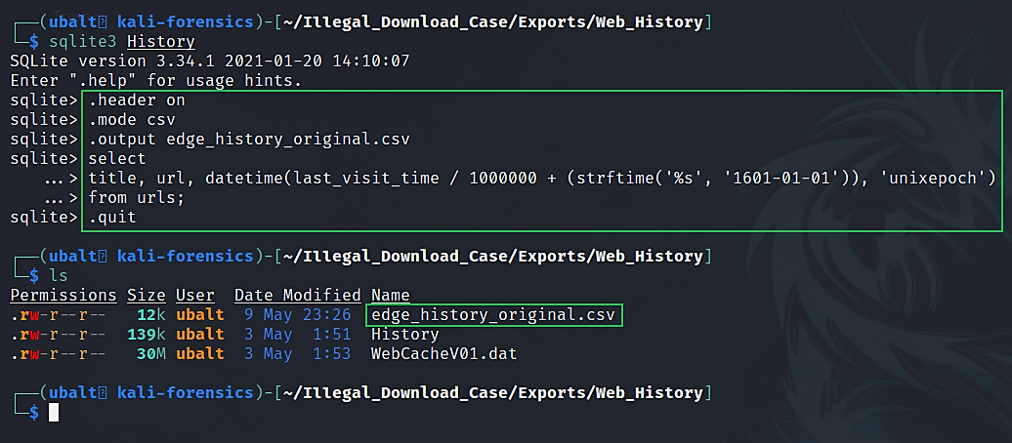
Export Edge’s history to a csv file.
Notes:
Code copied from: https://stackoverflow.com/questions/20458406/what-is-the-format-of-chromes-timestamps

Slide 25
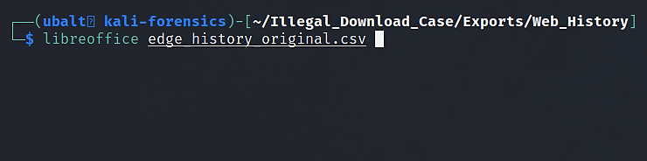
(Option 1) Use LibreOffice Calc to open the csv file.

Slide 26
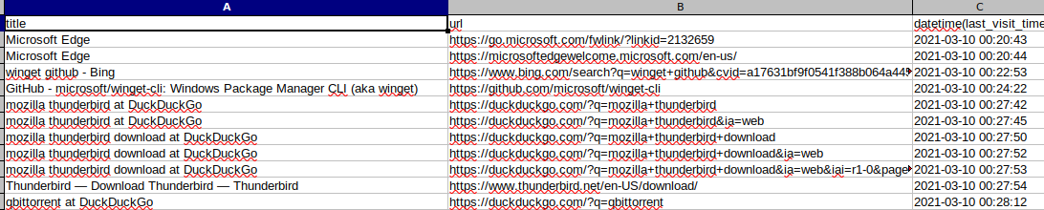
(Option 1) Use LibreOffice Calc to open the csv file.

Slide 27
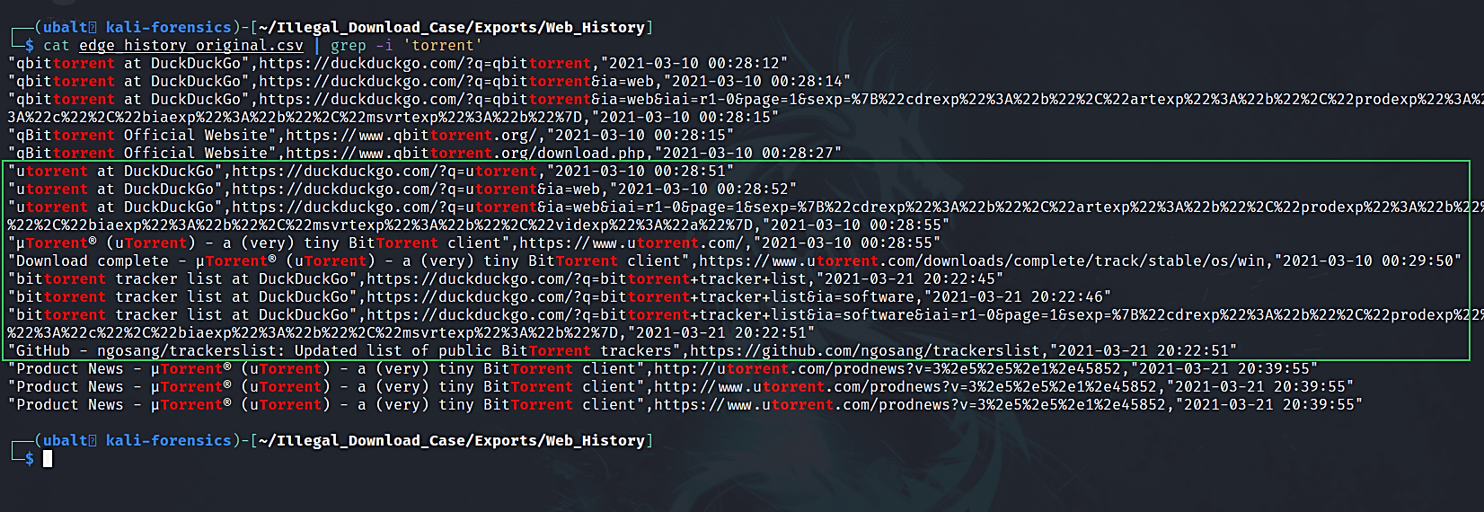
(Option 2) Analyze the history file in the terminal.

Slide 28
Overview of web activity.
On 3/10/2021 –
DuckDuckGo search for ‘mozilla thunderbird’ (00:27:42)
DuckDuckGo is a search engine like Google.
Web page opens that shows Thunderbird’s download (00:27:54)
DuckDuckGo search for ‘utorrent’ (00:28:15)
uTorrent website visited (00:28:55)
Web page opens that says uTorrent’s download is complete (00:29:50)
Suspect visits outlook.com (00:30:25)
Suspect is signing into Outlook email (00:30:29)
Suspect is signed into the ‘kamalle123@outlook.com’ email (00:34:56)

Slide 29
Overview of web activity.
On 03/21/2021 –
DuckDuckGo search for ‘bittorrent tracker list’ (20:22:45)
Suspect opens ngosang’s Github repository titled ‘trackerslist: Updated list of public BitTorrent trackers’ (20:22:51)
Suspect accesses text files from ngosang’s Github repository:
‘trackers_best.txt’ (20:24:11)
‘trackers_all_ip.txt’ (20:24:32)
‘trackers_best_ip.txt’ (20:25:52)
Suspect visits ‘Social Upload’ (20:46:42)
Suspect logs into this website (20:48:37)
Suspect visits a section of the website called ‘Files’ (20:50:39)
Suspect is creating a thread (20:50:42)
Suspect is in a thread titled ‘New Music’ (20:53:19)

Slide 30
Explanation
By looking at the web history, we have more information about the suspect’s activities:
The ‘kamalle123@outlook.com’ email address was accessed on Outlook.
The suspect downloaded Thunderbird.
The suspect downloaded uTorrent.
The suspect accessed a tracker list on Github.
The suspect accessed a website called ‘Social Upload’ and created the thread ‘New Music’.
We can look at the ‘downloads’ table from Edge’s history file to get specific information about when the downloads took place.

Slide 31
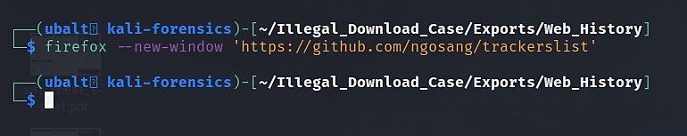
(Optional) View and save the Github page for your records.

Slide 32
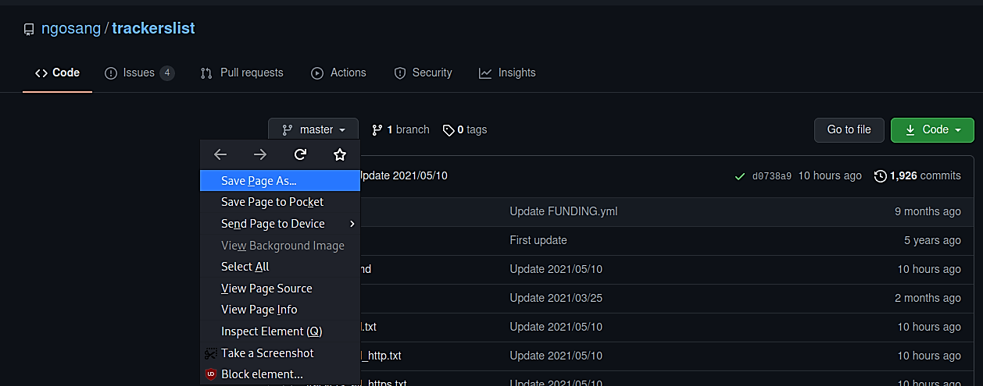
(Optional) View and save the Github page for your records.

Slide 33
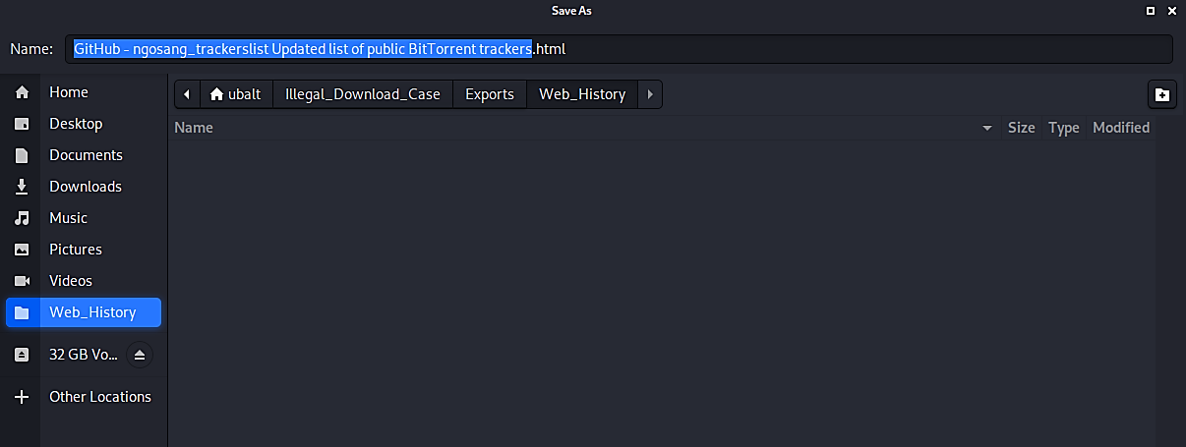
(Optional) View and save the Github page for your records.

Slide 34
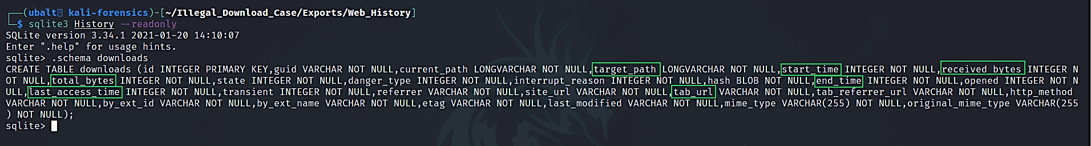
Use sqlite3 to get downloads.

Slide 35
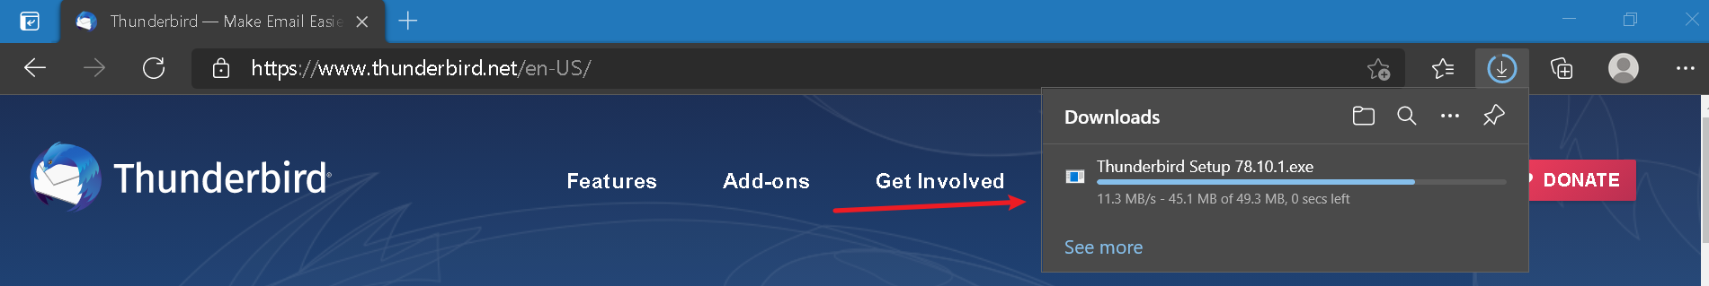
Explanation
The ‘downloads’ table stores the history of downloads within the web browser.
The activity shown in this screenshot would be recorded in the ‘downloads’ table:

Slide 36
Explanation
All entries inside of the green rectangles are columns within the ‘downloads’ table:
‘target_path’ refers to the file path the downloaded item is saved to.
‘start_time’ is when the download starts. ‘end_time’ is when the download ends.
‘received_bytes’ is the number of bytes downloaded from the website. ‘total_bytes’ is the number of bytes downloaded in total.
If ‘received_bytes’ is the same as ‘total_bytes’, then the suspect successfully downloaded the file.
‘tab_url’ shows the url where the download took place.
‘last_access_time’ shows when a downloaded file was opened from the web browser.

Slide 37
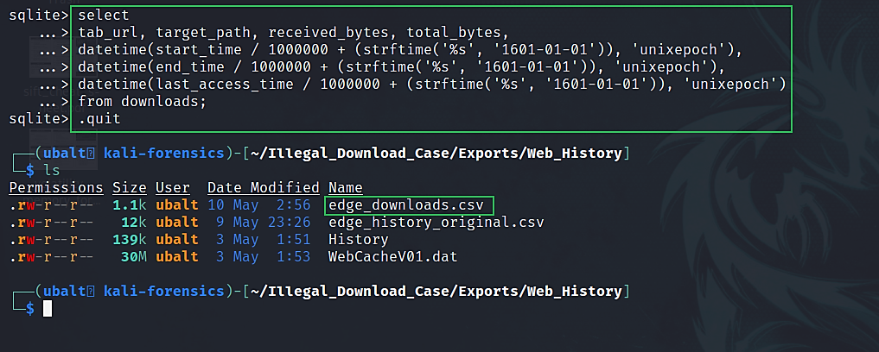
Export Edge’s download history to a csv file.

Slide 38
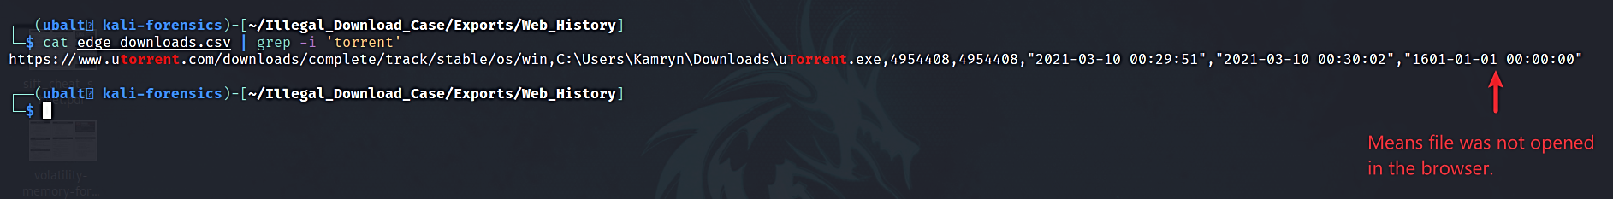
Look at edge’s download history in the terminal.

Slide 39
Explanation
We now have more detailed information on the suspect’s download history.
With these entries, we can update our timeline of the browsing history:

Slide 40
Updated overview of browsing history.
On 3/10/2021 –
DuckDuckGo search for ‘mozilla thunderbird’ (00:27:42)
DuckDuckGo is a search engine like Google.
Web page opens that shows Thunderbird’s download (00:27:54)
Thunderbird downloaded
Download started (00:27:58)
Download ended (00:28:08)
DuckDuckGo search for ‘utorrent’ (00:28:15)
uTorrent website visited (00:28:55)
Web page opens that says uTorrent’s download is complete (00:29:50)
uTorrent downloaded
Download started (00:29:51)
Download ended (00:30:02)
Suspect visits outlook.com (00:30:25)
Suspect is signing into Outlook email (00:30:29)
Suspect is signed into the ‘kamalle123@outlook.com’ email (00:34:56)

Slide 41
Updated overview of browsing history.
On 03/21/2021 –
DuckDuckGo search for ‘bittorrent tracker list’ (20:22:45)
Suspect opens ngosang’s Github repository titled ‘trackerslist: Updated list of public BitTorrent trackers’ (20:22:51)
Suspect accesses text files from ngosang’s Github repository:
‘trackers_best.txt’ (20:24:11)
‘trackers_all_ip.txt’ (20:24:32)
‘trackers_best_ip.txt’ (20:25:52)
Suspect visits ‘Social Upload’ (20:46:42)
Suspect logins to this website (20:48:37)
Suspect visits a section of the website called ‘Files’ (20:50:39)
Suspect is creating a thread (20:50:42)
A ‘thread’ is a post on a forum that other people can look at and/or respond to.
Suspect is in a thread titled ‘New Music’ (20:53:19)

Slide 42
Explanation
Download entries were not seen for the text files. If any of the entries are on the suspect’s system, they may have been copy and pasted.
The timestamps for the downloads are consistent with what was recovered from the MFT timeline.
From the emails, we know that the suspect was in contact with alleged leakers. We must check ‘Social Upload’ to see if anyone uploaded any of the files we recovered.

Slide 43
How do peers to find each other?
Peer asks Torrent tracker to find other peers
A Torrent tracker is a special type of server that assists in the communication between peers using the BitTorrent protocol
How?
The peer sends a message to the tracker to register its interest in a torrent.
The tracker responds with a list of other peers (.txt) who have previously expressed interest.
Then the peer connects directly to each of the peers it received from the tracker.

Slide 44
Things the tracker does NOT do
The tracker does NOT act as a proxy or middle-man between the peers.
The tracker does NOT relay data between peers.
The tracker CANNOT see what pieces of the torrent each peer has.
The tracker CANNOT see the .torrent file (or any metadata contained within the .torrent file, like the list of file names).
Notes:
https://www.quora.com/What-is-a-torrent-tracker

Slide 45
The suspect accessed trackers (text files)?
Recall that when we looked at the recent documents the suspect opened, there were three text files:
List-1.txt
List-2.txt
List-3.txt
Do these text files have any useful information? Let’s find out!

Slide 46
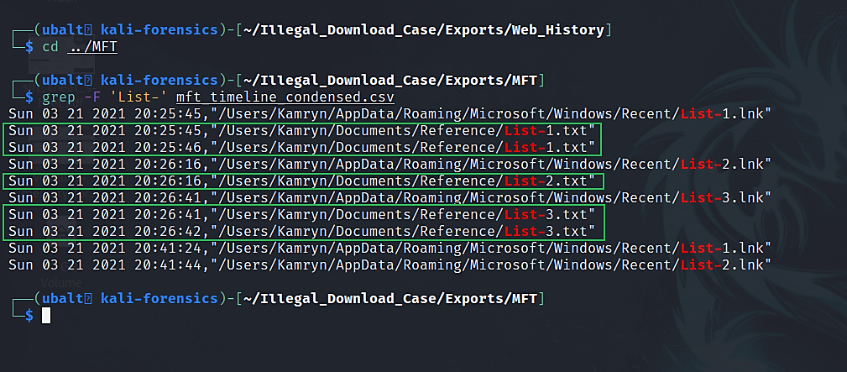
Reference the MFT timeline to search for the ‘List-’ text files.

Slide 47
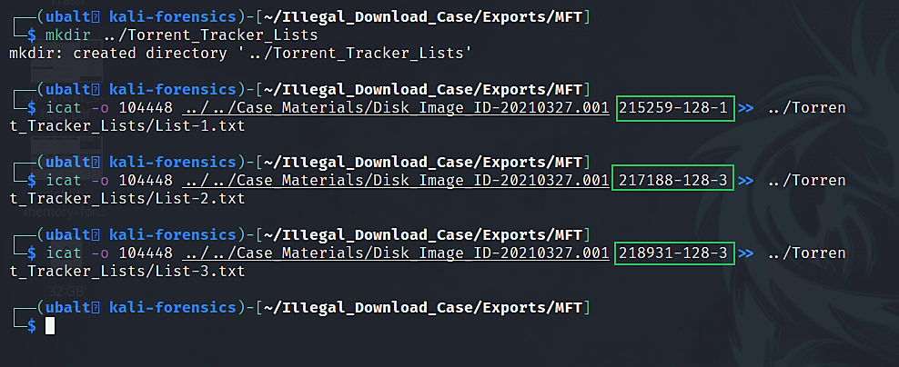
Extract the text files.

Slide 48
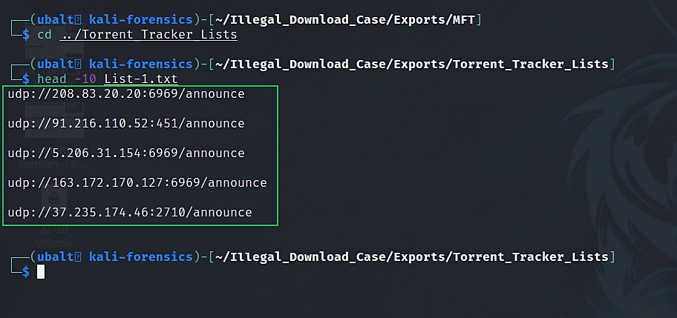
Look at the text files.

Slide 49
Explanation
These text files contain trackers.
The trackers from the text files were used for the torrents that are on the system.
The creation timestamps from the text files are close to when the suspect/their torrent clients looked at text files within the browser. It is possible that these trackers came from ngosang’s Github.
Notes:
Clipboard history could be a possible question for the memory image.

Slide 50
What does this mean for the investigation?
We can confirm the time period of Kamryn downloading uTorrent.
The trackers used for the torrent files may have been from the Github page Kamryn visited.
This can be validated by checking the clipboard history from the memory image.
We have the hyperlink to ‘Social Upload’. If Kamryn uploaded any of the .mp3 files, she may have done it on this website.

Slide 51
Next Presentation
Website Analysis

